Slide 1
NOMA/FONOM Process and Product Development Project
Forestry 101 – Trees are the Solution
Client – NOMA and FONOM
Dean Caron, RPF
Industry Advisor FPInnovations

Slide 2
Dean Caron - Background
Born, raised and based in Kenora Ontario.
Honours Bachelor of Science Forestry Degree and Forest Technician Diploma from Lakehead University.
Registered Professional Forester (RPF) Ontario.
Worked in BC (Interfor Tofino - Engineering), Alberta (Canfor Hines Creek - Planning) and Northwestern Ontario (Weyerhaeuser Ear Falls – Area Leader, Weyerhaeuser Kenora – Aboriginal Business Development Leader, Boise Cascade Canada (Resolute) Fort Frances/Kenora - Student).
Eight years with government (Ministry of Northern Development and Mines) doing economic development work (natural resources, First Nations and NOHFC evaluator).
30 years in the forest industry (direct and indirect).
Been with FPInnovations since April of 2015 (Industry Advisor – Forest Operations/Fibre Supply).

Slide 3
About This Presentation/Project
Initially developed for political leaders of Northern Ontario to better understand, defend and promote the forest industry.
This project involves the work of a great number of people and organizations.
This presentation has been delivered to several thousand people all over the province and in other provinces as well.
It is based on facts and science.
It is one of the most rewarding projects I have lead/been involved in my career!

Slide 4
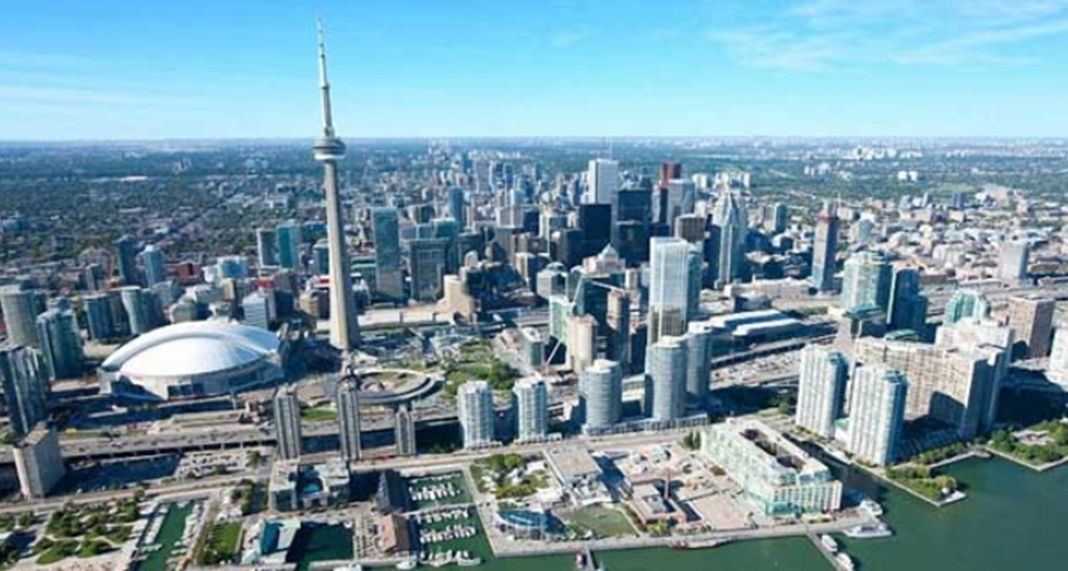
Deforestation - Cities
But 7 billion people need a place to live…

Slide 5
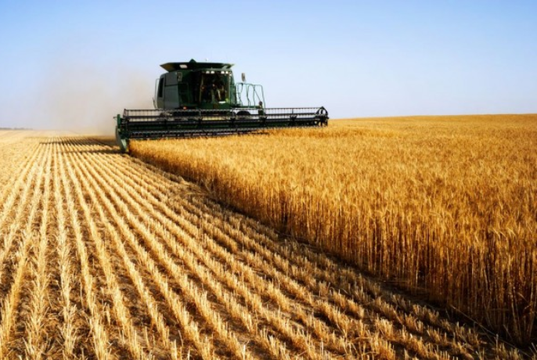
Deforestation - Agriculture
But 7 billion people need food to eat…

Slide 6
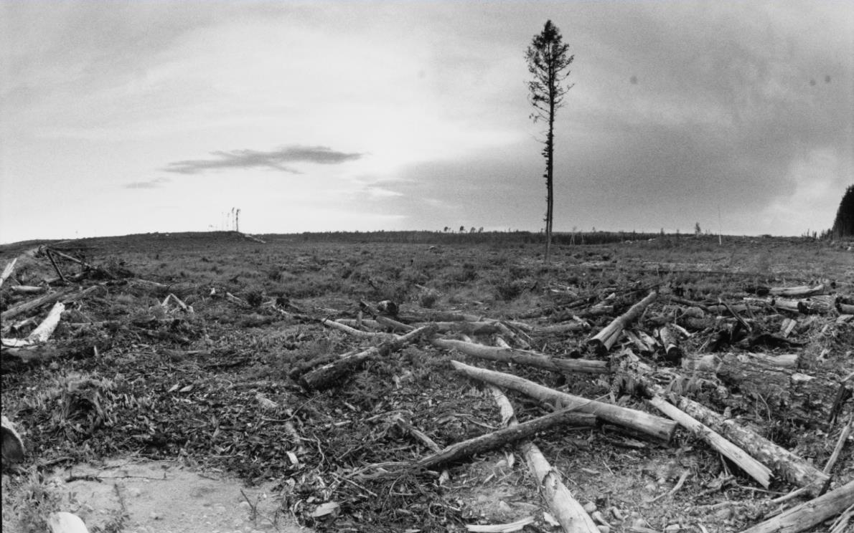
Deforestation According To Our Critics
Picture from north of Kenora about 18 years ago (2000)…
Yes – logging can look ugly immediately after harvest but…

Slide 7
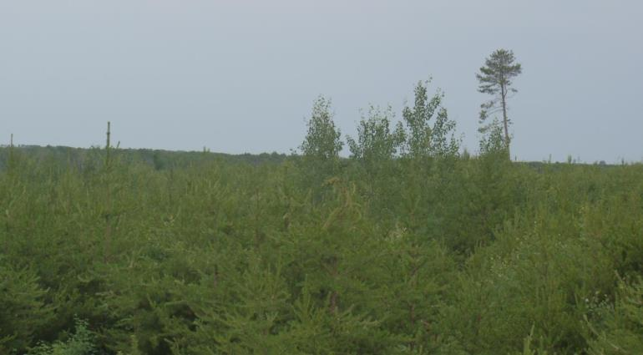
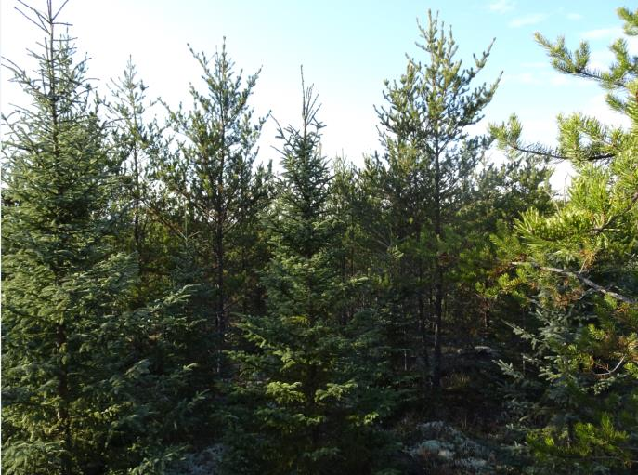
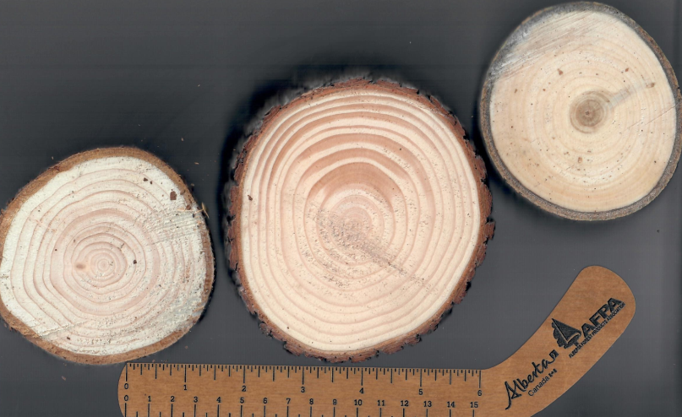
Here Is What It Looks Like 15 years Later…
Forestry is NOT deforestation – it is reforestation!
2014
2015
2015
Notes:
In 2015: Biggest trees were 6 inches in diameter and up to 30 feet tall. Average was about 23 feet to 27 feet and diameters 3 to 4 inches. Range about 5 feet to 30 feet tall with diameters of 1 inch to 6 inches.

Slide 8

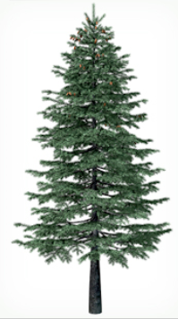

Anyone use some of this today?
Guess what I’m made from?

Slide 9
Agenda
Forest Succession in Northern Ontario
Carbon Cycle Impacts of Forest Operations and Forest Products
Woodland Caribou and Forest Management in Northern Ontario
Use of Wood in Everyday Life
Economic Impact of Forestry in Ontario
Summary
Please save questions for the end.

Slide 10


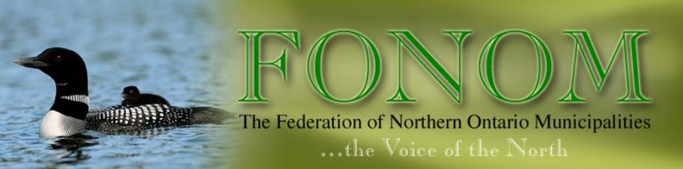
Section One: Forest Succession in Northern Ontario

Slide 11
What Is Forestry?
Forestry is defined as:
  “The science, art and practice of managing and using trees, forests and their associated resources for human benefit.”
Source: OMNRF

Slide 12
Crown Forest Sustainability Act – Legislation Governing Ontario’s Crown Forests
Requires that Crown forests be managed sustainably (providing for the long term forest health) while supplying social, economic, and environmental needs for present and future generations.
“…using forest practices that, within the limits of silvicultural requirements, emulate natural disturbances and landscape patterns while minimizing adverse effects on plant life, animal life, water, soil, air and social and economic values, including recreational values and heritage values.”
Source: OMNRF/Crown Forest Sustainability Act

Slide 13
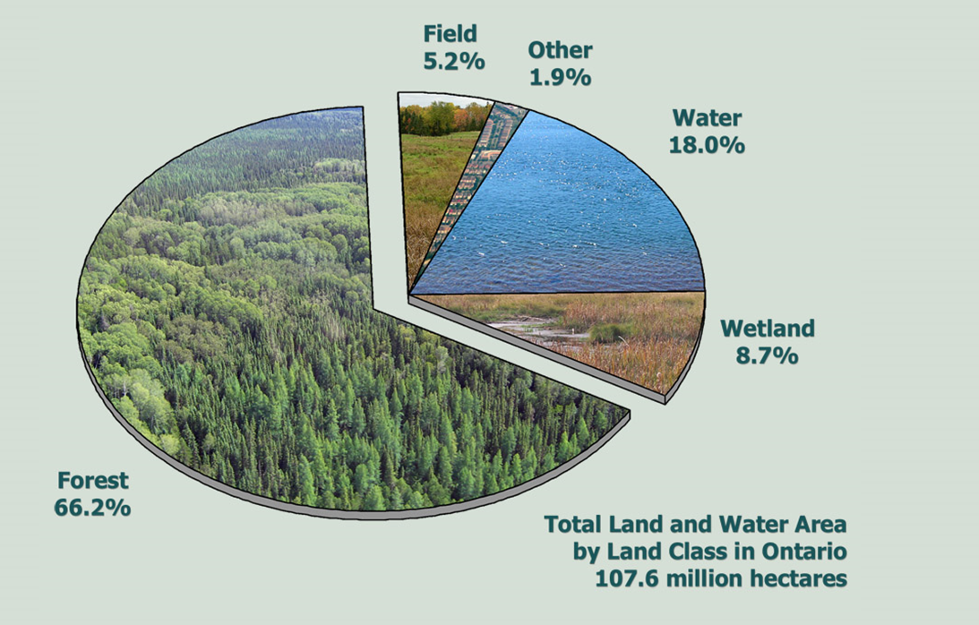
Land Class Breakdown in Ontario
Source: OMNRF

Slide 14
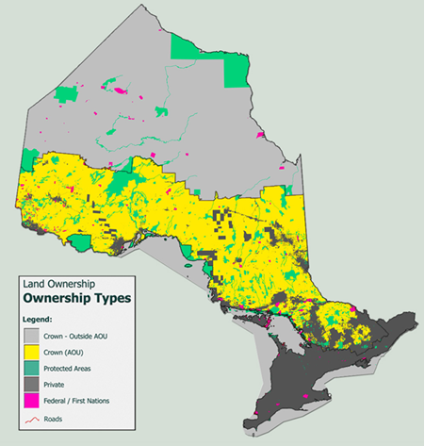
Ontario’s Forest – Ownership Types
39.3 million ha (37%) subject to forest management (Area of Undertaking).
45.3 million ha (42%) not subject to forest management.
9.9 million ha parks and protected areas – commitment for another 22.5 million ha (50% of Far North).
Source: OMNRF
Notes:
In the boreal forest we have achieved more parkland than UN standard of 12%

Slide 15
Forest Regions In Ontario
Lowlands: Wetlands with a component of shrub sized black spruce, white spruce, willow and tamarack (larch).
Boreal Forest: spruce, jack pine, balsam fir (SPF) with birch, poplar and tamarack (larch) (low grade hardwoods).
Great Lakes - St. Lawrence: a mix of red pine, white pine, SPF and hardwoods including oak, maple, yellow birch, beech, basswood etc.
Kenora
Toronto
Source: OMNRF

Slide 16
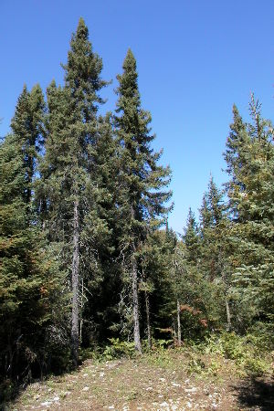
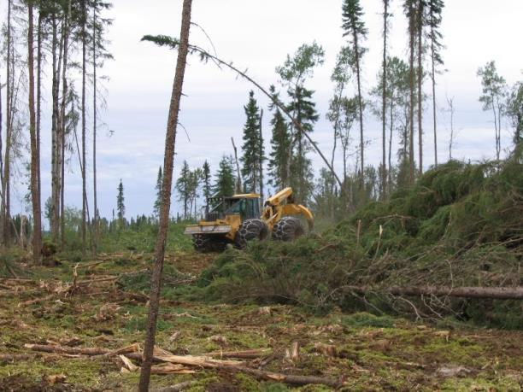
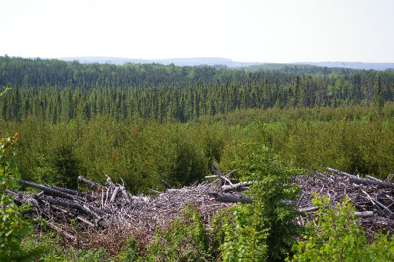
Ontario’s Boreal Forest
Primarily shade intolerant species (need disturbance and full sunlight to grow and regenerate); even-aged forests; fire origin.
Harvesting – primarily clear cut silviculture system; stands harvested once every ~ 60 to 100 years (depends on species); emulate natural disturbance patterns.
Source: OMNRF

Slide 17
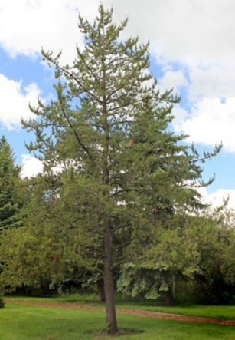
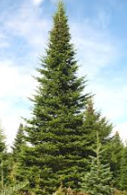
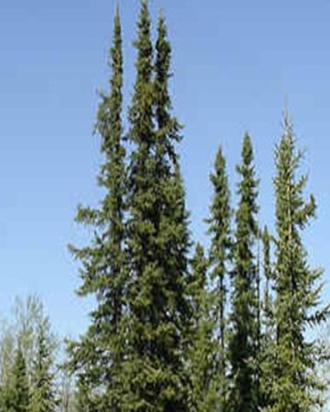
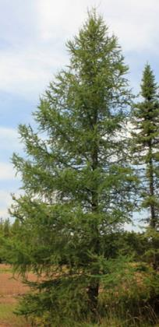
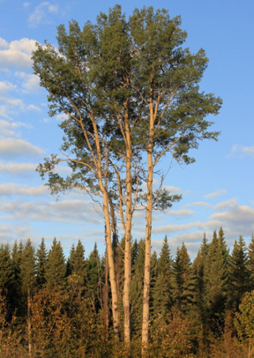
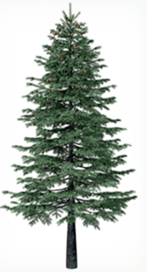
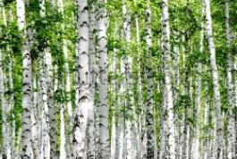
Common Boreal Forest Trees in Northern Ontario
Balsam Fir – Shade Tolerant
Black Spruce – Semi Shade Tolerant
Tamarack – Shade Intolerant
Jack Pine – Shade Intolerant
White Birch – Shade Intolerant
White Spruce – Semi Shade Tolerant
Trembling Aspen – Shade Intolerant

Slide 18
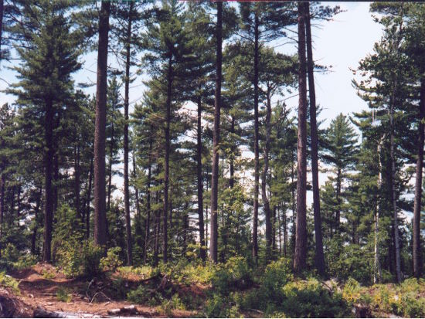
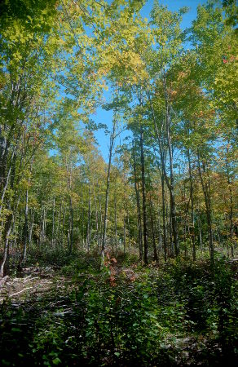
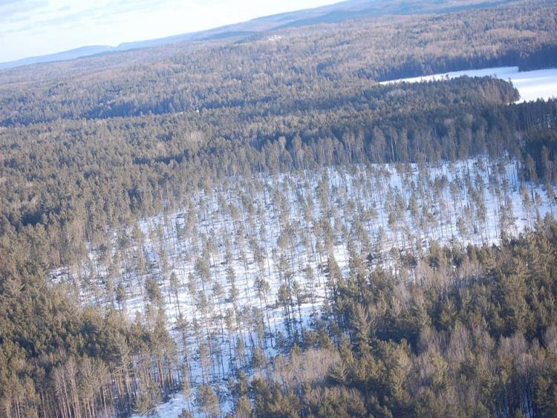
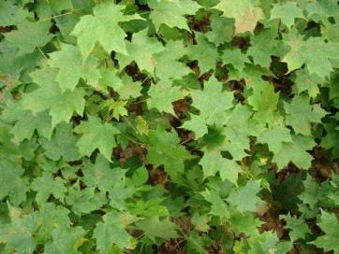
Ontario’s Great Lakes St. Lawrence Forest
Primarily shade tolerant species (regenerate under shade or partial shade).
Harvesting – partial cutting systems (enter stands every 20-30 years) primarily shelterwood and selection silviculture systems, e.g.,
  White pine, yellow birch, red oak – shelterwood.
  Maple, beech – selection.
  Red pine – clear cut with seed trees.
Source: OMNRF

Slide 19
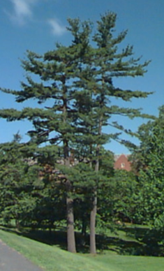
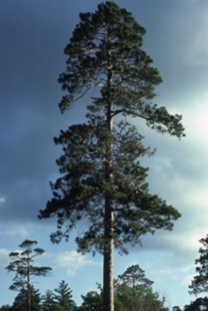
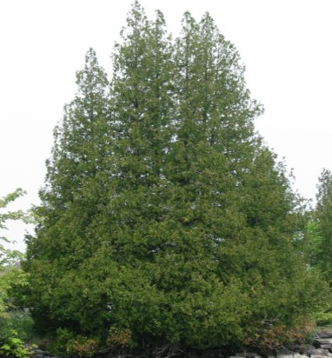
Great Lakes St. Lawrence Trees That Are Common In Southern Boreal Forest
Red Pine – Semi Shade Tolerant
Eastern White Cedar – Shade Tolerant
White Pine – Semi Shade Tolerant
Notes:
75% crown closure for white pine, 25 % for red pine.

Slide 20


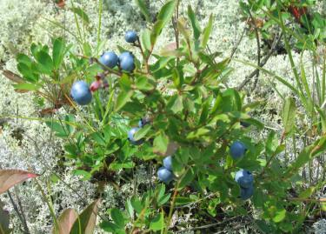
What Happens If No Clear Cutting In Boreal Forest of Northwestern Ontario?
x
x
x
x
x
x
x
Jack Pine – Shade Intolerant
Balsam Fir – Shade Tolerant
Black Spruce – Semi Shade Tolerant
Tamarack – Shade Intolerant
Blue Berries – Shade Intolerant
White Birch – Shade Intolerant
White Spruce – Semi Shade Tolerant
Trembling Aspen – Shade Intolerant

Slide 21
What Happens If No Clear Cutting (Northwestern Ontario - Example)
X
Kenora Forest Products (Kenora)
Weyerhaeuser (Kenora)
Domtar (Dryden)
EACom (Ear Falls)
Norbord (Barwick)
Whitefeather (Pikgangikum/Red Lake)
Resolute (Ignace, Atikokan, Thunder Bay x 2)
AV Terrace Bay (Terrace Bay)
NFMC (Marathon)
All directly and indirectly dependent businesses.
Public infrastructure supported by the industry and people.

Slide 22
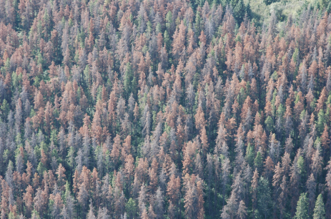
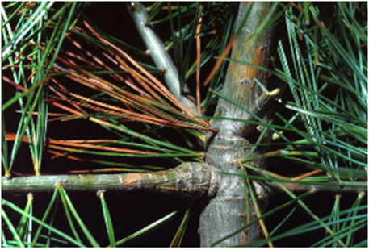
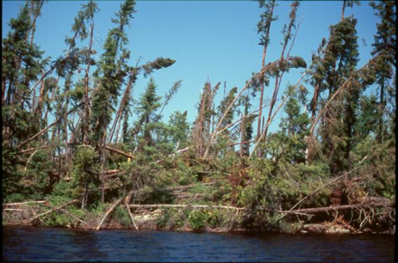
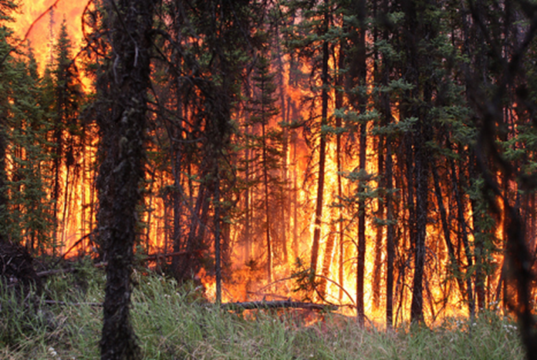
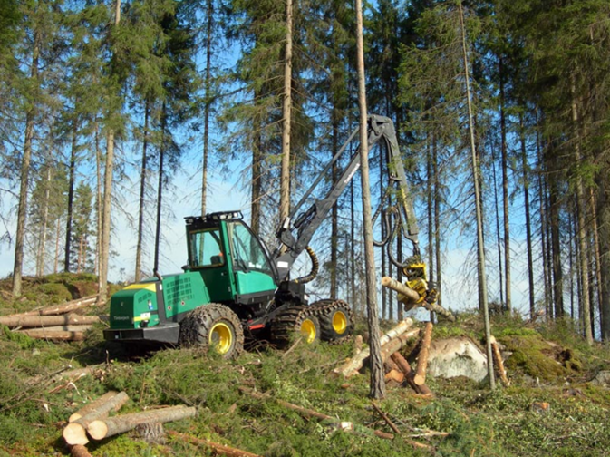
Types of Forest Disturbances – The Reset Button
Insects
Disease
Wind
Harvesting
Fire

Slide 23
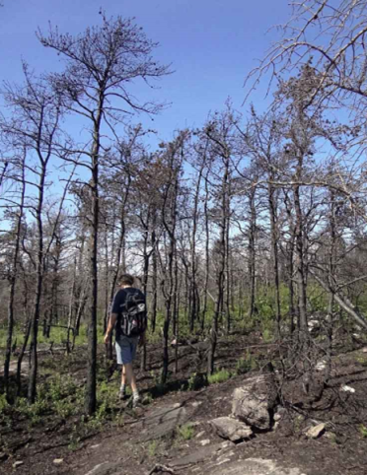
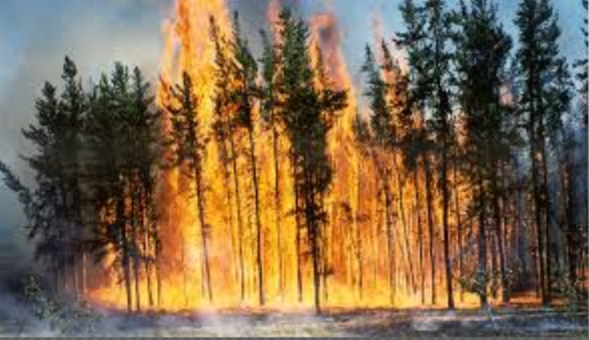

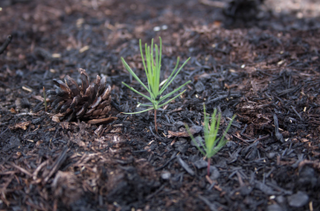
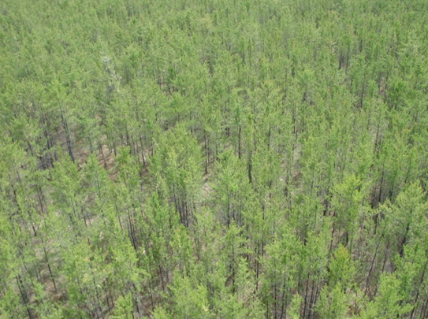
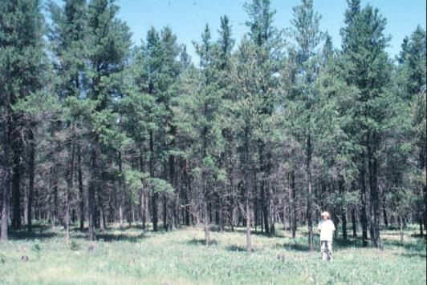
Natural Forest Succession – Forests Change Over Time
Natural forest disturbances and logging may not be look visually pleasing at the onset of the disturbance.

Slide 24
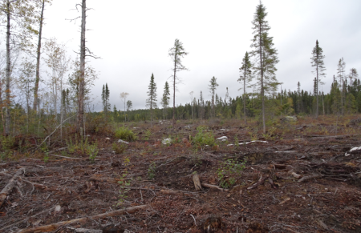
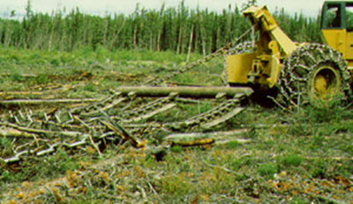
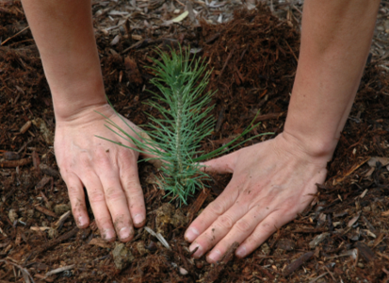
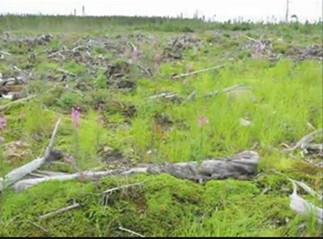
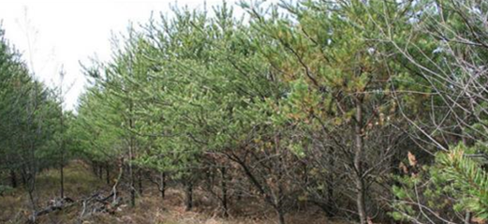
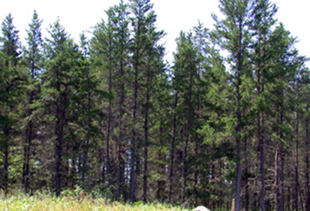
Artificial Forest Succession – Forests Change Over Time
Natural and man made disturbance in general is not visually appealing to most – but as you will see – it does come back!

Slide 25
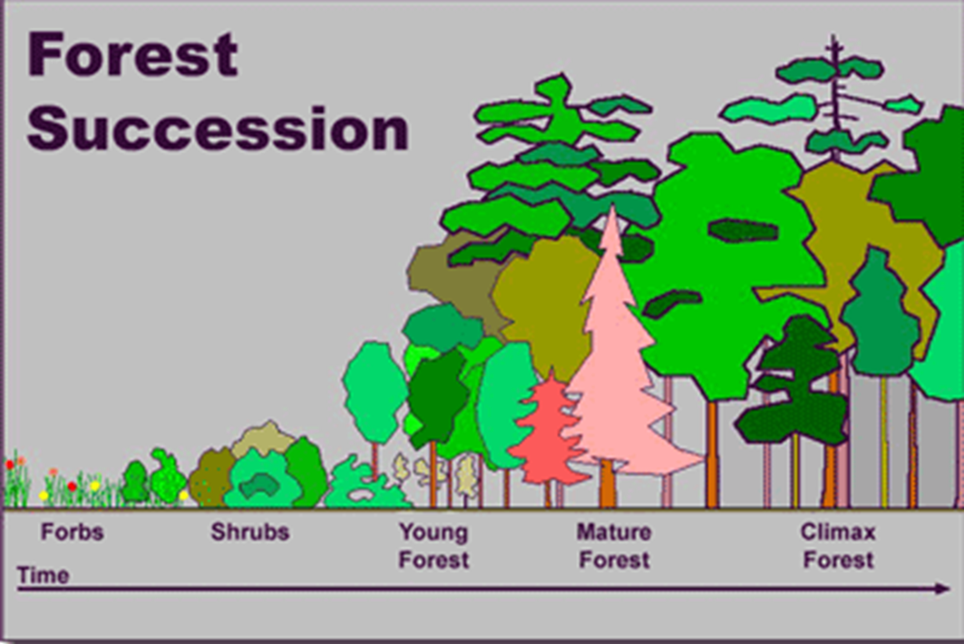
Disturbance Then Succession – It Is A Repeating Process

Slide 26
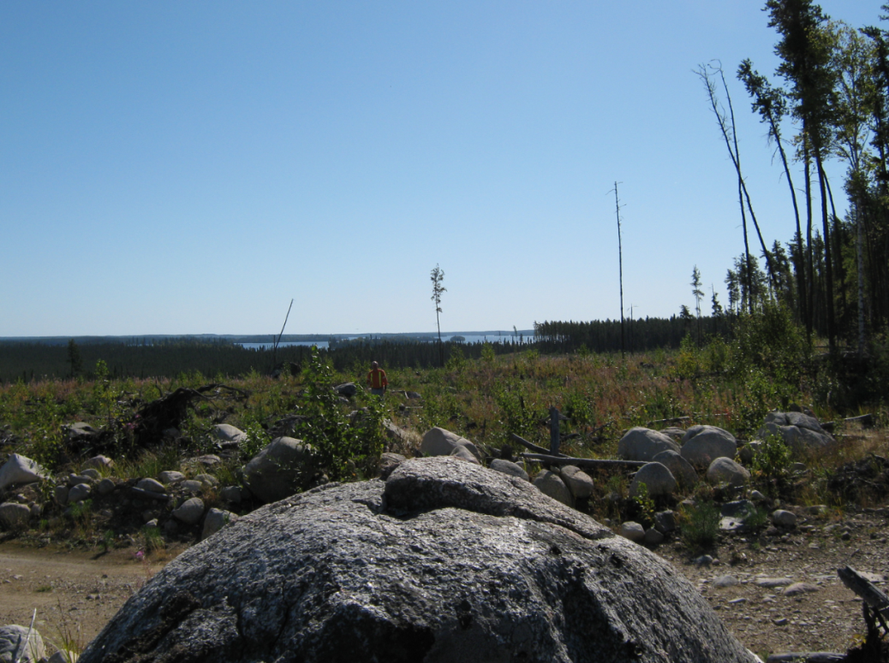
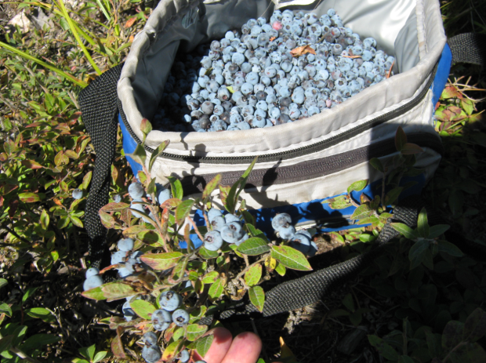
Sioux Narrows Area
Source: Weyerhaeuser
Two year old jack pine aerial seeded – note blue berries in block as well.

Slide 27
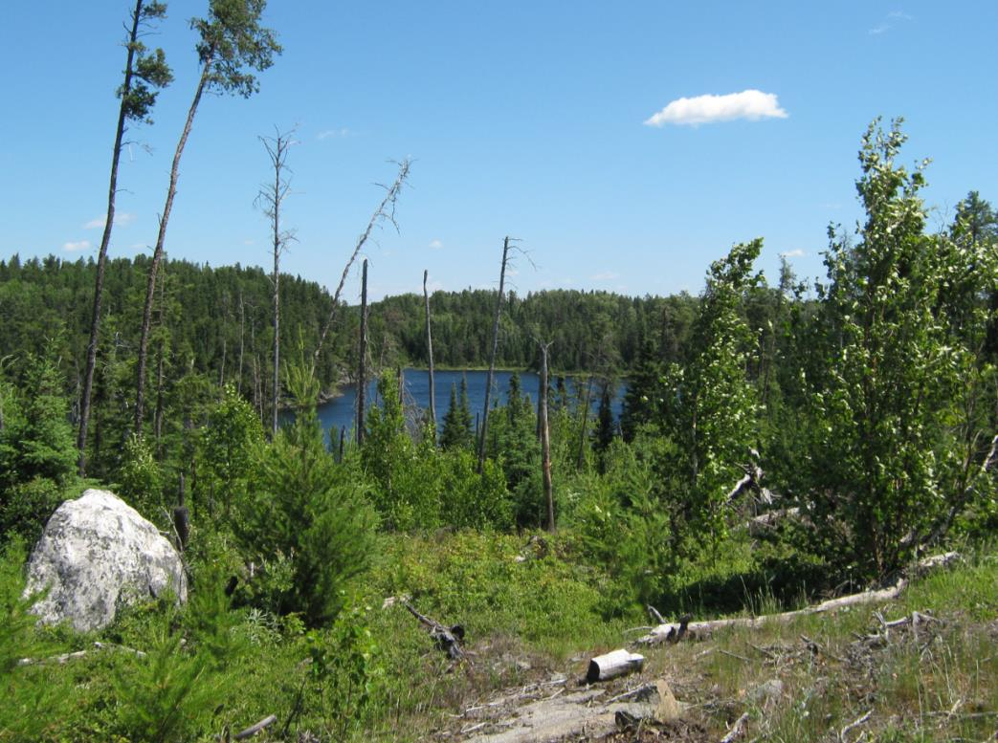
North of Kenora
Six year old jack pine and black spruce (natural regeneration).
Source: Weyerhaeuser

Slide 28
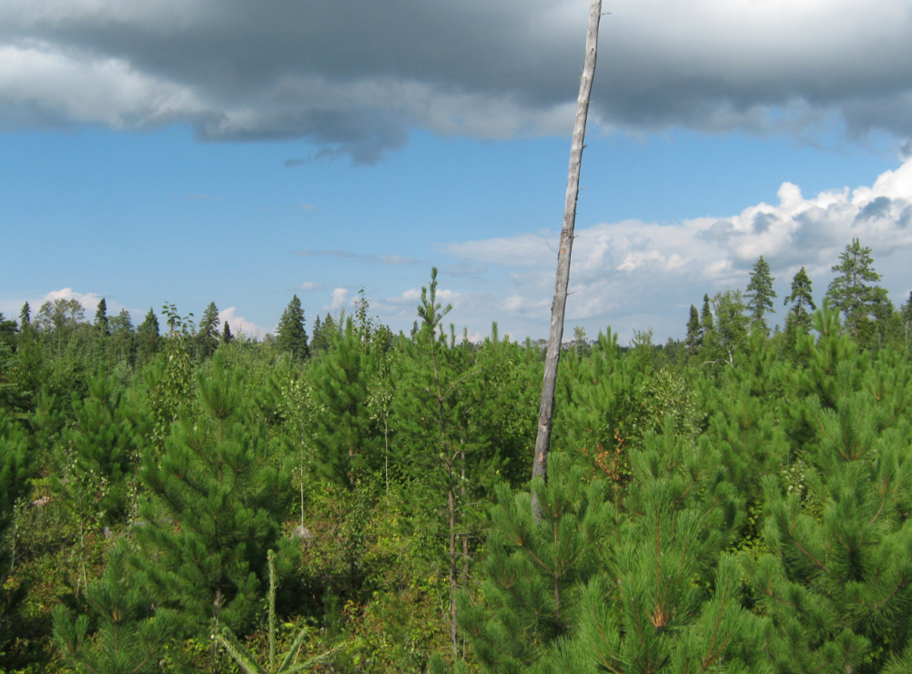
Sioux Narrows Area
Eight year old red pine plantation with brush saw thinning.
Source: Weyerhaeuser

Slide 29
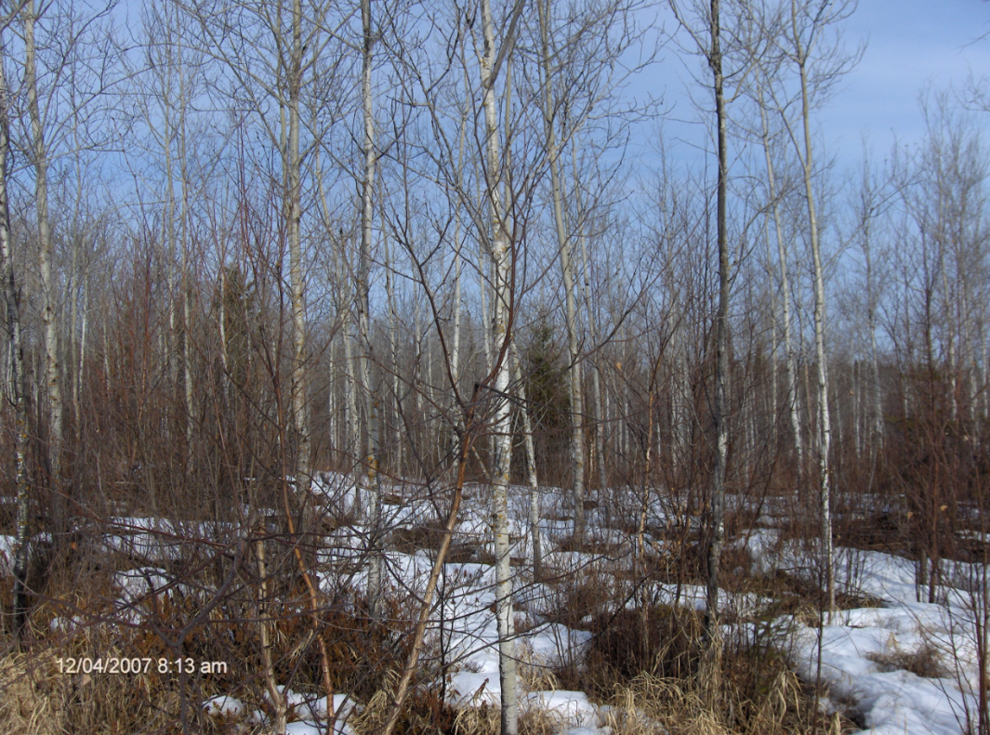
Minaki Area
12 year old thinned trembling aspen.
Source Weyerhaeuser Kenora

Slide 30

Sowden Lake Area (Ignace)
Note: ground lichen – woodland caribou preferred food
15 year old thinned jack pine aerial seeded.
Source: Weyerhaeuser

Slide 31

Highway 17 ~10 km East of Ignace
2015
Year of harvest: 2004 (11 years ago), planted 2005 jack pine, red pine, black spruce, white spruce, herbicide ground application in 2007.

Slide 32

Highway 17 ~15 km East of Ignace
Harvest 2000
Harvest 2013
2015
Left: harvest 2000 (15 years ago), site preparation mechanical drags 2001, planted 2002 black spruce and jack pine. Right: harvest 2013, site preparation power trencher, planted 2014 jack pine, red pine, black spruce.

Slide 33

Highway 17 ~35 km East of Ignace
43 year old cut
mature forest
5 year old jack pine
2015
Foreground year of harvest 2008, site preparation mechanical trencher 2008, planted 2010 jack pine and black spruce. Background harvest 1972.

Slide 34

Highway 17 ~51 km east of Ignace
Harvest 2013
Harvest 1991
2015
Left: year of harvest 2013, mechanical trencher site preparation 2013, planted jack pine, red pine and black spruce in 2014. Right: year of harvest 1991 (24 years ago), seeded to jack pine.

Slide 35

Highway 17 ~ 63 km East of Ignace (North Side of Highway)
2015
Year of harvest 2008 (seven years ago), planted 2008 jack pine and black spruce.

Slide 36

Highway 17 ~ 66 km East of Ignace
2015
Harvested in 2015, silviculture to commence in 2016.
Notes:
It could be successfully argued that silviculture actually commences at the harvest stage as if the harvest is not done adequately regeneration could be challenged.

Slide 37


Highway 17 ~ 83 km east of Ignace
2015
Harvested in 2015, to be planted in 2016. Note: natural regeneration already occurring.

Slide 38

Smooth Rock – Black Spruce 20 Years Old

Slide 39

Cochrane Area – 30 Year Old Black Spruce

Slide 40






Human Succession and Forest Succession – Change is Constant
Source: Dean Caron
Notes:
Derian Caron. Born February 24, 1998. 1st picture (baby), 2nd picture (four years old), 3rd picture (about 12 years old), 4th picture (16 years old), 5th picture (17 years old), 6th picture (18 years old). Derian is currently attending Lakehead University, pursuing Honours Bachelor of Science degree in Forestry (commenced in the fall of 2016).

Slide 41



Here Is An Area I Tree Planted In Grade Six (38 Years Ago)…
1980
2015
2015

Slide 42


We Are Leaders in Forest Certification
Nearly 4X better than the next closest country!
Source: Andrew de Vries SFI Inc.
Notes:
BC 57, Que 38, ON 27, AB 19, MB 11, SK 7, NB 1, NF 1, NS 1
It is assumed that Ontario’s certified forest is less than BC and Quebec as Ontario has less forest under forest management (area of under taking is 42% of province).

Slide 43
Sound and Enviable Track Record
Recognition of balanced approach (sharing the forest).
Numerous studies rank Ontario as a global/national leader in sustainable forest management:
  Yale University
  InduforOy/Forestry Innovation Investment
  Canadian Boreal Forest Agreement
“Within the Canadian context, Ontario has developed one of the most comprehensive and prescriptive forest management planning systems in the country.”
“In general, Ontario has developed a highly evolved regulatory system under the CFSA.”
CBFA Report – Status Report on Ecosystem-based Management (EBM): Policy Barriers and Opportunities for EBM in Canada.
Source: Scott Jackson
Notes:
Could delete

Slide 44

Carbon Cycle Impacts of the Forest Industry

Slide 45
Forests As Carbon Sources And Carbon Sinks
Forests can act as either carbon sources or carbon sinks.
A forest is considered to be a carbon source if it releases more carbon than it absorbs.
A forest is considered to be a carbon sink if it absorbs more carbon from the atmosphere than it releases.
This process of carbon absorption and deposition is known as carbon sequestration.
Source: Werner Kurz, Natural Resources Canada
Notes:
. Forest carbon is released when trees burn or when they decay after dying (as a result of old age or of fire, insect attack or other disturbance).
Green house gases (GHGs) such as carbon dioxide (CO2) and methane (CH4) are emitted when fossil fuels are burned and organic matter decomposes, etc.
CO2 is the main GHG accounting for about 80% of all GHGs.
According to the Global Carbon Project (GCP) the burning of fossil fuels and the production cement is the leading cause of increased CO2 concentration in the atmosphere.
The safe level is 350 parts per million (ppm), we’re now at 400 ppm.
Could push temperatures 2 degrees above current global temperatures and result in potentially more extreme climatic events.

Slide 46

Carbon Cycle
Image credit: PASavvaerk.
Notes:
Image: http://mmd3semspring2012.mmd.eal.dk/group7/pa/environment.html
Forest capture CO2 from atmosphere
Harvest logs with smaller branches left in the forest
Decomposition of branches releases carbon over time; if material is burned for energy, carbon is immediately released.
CO2 emissions occur during harvest especially when machinery using diesel / gasoline / natural gas / heavy oil are used
Carbon is stored for as long as product is in service
At end of service life, product be reclaimed, reused, recycled or burned for energy
Cycle continues….
Wood is a renewable resource. In Canada, harvested forests will regrow over approximately 60-80 years.
Harvest is different from deforestation "permanent removal of forest cover and withdrawal of land from forest use, whether deliberately or circumstantially." Similarly, the IPCC Guidelines emphasize the conversion of forests (to pasture, cropland, or other managed uses): "Conversion of forests is also referred to as 'deforestation,' and it is frequently accompanied by burning."
http://www.ipcc.ch/ipccreports/sres/land_use/index.php?idp=49

Slide 47



Managed stands grow faster, produce more volume and therefore sequester more carbon than natural stands.
Greatest rate of annual growth. Carbon sequestration and oxygen production is maximized.
As trees/stand age, growth slows. The rate of carbon sequestration and oxygen production is minimized.
Source: Scott McPherson Nipissing Forest Resource Management
Notes:
http://www.nrcan.gc.ca/forests/climate-change/forest-carbon/13085
Forests can act as either carbon sources or carbon sinks.
•A forest is considered to be a carbon source if it releases more carbon than it absorbs. Forest carbon is released when trees burn or when they decay after dying (as a result of old age or of fire, insect attack or other disturbance).
•A forest is considered to be a carbon sink if it absorbs more carbon from the atmosphere than it releases. Carbon is absorbed from the atmosphere through photosynthesis. It then becomes deposited in forest biomass (that is, trunks, branches, roots and leaves), in dead organic matter (litter and dead wood) and in soils. This process of carbon absorption and deposition is known as carbon sequestration.
The net balance of all of these carbon exchanges determines whether a forest is a carbon source or sink. Yet, the carbon source/sink balance is as dynamic as it is complex.
For the past century, Canada's managed forests have been a significant carbon sink, steadily adding carbon to that already stored. In recent decades, however, the situation has reversed in some years: Canada’s forests have become carbon sources, releasing more carbon into the atmosphere than they are accumulating in any given year.
Several factors have contributed to this shift. The annual total area burned by wildland fires has increased substantially. Unprecedented insect outbreaks have occurred. And annual harvest rates have shifted dramatically in response to economic demand, increasing in the 1990s and decreasing sharply with the global economic recession.
The combination of these events and activities has resulted in Canada’s managed forest acting as a net carbon source in years when large areas are burned.

Slide 48





Carbon dioxide impact summary 1m3 (~118 2”x4”x8’) of Canadian lumber
Red (positive values) is CO₂ released (pollution)
Green (negative values) is CO₂ sequestered
15 times better!
One car puts out ~3,000 kg CO₂ per year. 3.84 m3 or 435 2”x4”x8’ SPF hold 3,000 kg of CO₂
Harvest (10) + Haul (7) + 32 (sawmill) – Sequestration (780)
Notes:
Wood products remain in service for long time.
Housing: minimum 80 years.
Buildings: minimum 65 years.
Furniture: 30 years.
Paper: 1-6 years.
Canadian lumber is cleaner than US, electricity is cleaner.
At end of service life wood can be landfilled, recycled or burned for energy
In landfills, some emissions from decomposition happens (116 kg CO2 eq. per m3 of lumber) – recycling can reduce or eliminate this.
Mainly long-term storage
Other options:
Recycling to avoid production of products from virgin resource
Burning to replace fossil energy
1m3 of dry 2” x 4” x 8’ lumber (118 pieces) weighs approximately 780 kg.
It is made up of primarily carbon dioxide.
Approximately 50% is carbon
Approximately 42% is oxygen
Approximately 6% is hydrogen
Approximately 1% is nitrogen
Fort McMurray Fire
589,552 ha burnt Fort McMurray fire
50 m3 per ha (assumption - guess) could be 0 to over 300
29,477,600 volume burnt
780 kg/m3 of CO2 in SPF
22,992,528,000 CO2 released
3,000 Annual CO2 one car
7,664,176 Equivalent annual car emmissions
CO2 Sequestered in one log truck load of SPF
3,000.00 kg CO2 one car
780.00 kg CO2 in one m3 of SPF
3.85 m3 = annual emmission one car
50.00 m3 one log truck
13.00 annual car emmissions are contained within one 50 m3 load of SPF

Slide 49

Net CO₂ Emissions: How Wood Compares
The CO₂ absorbed by growing forests and stored in wood products offsets energy required to harvest, process, transport and maintain those products.
This is why wood product net emissions is below zero.
Wood ~-0.75 tonnes
Cement ~+0.5 tonnes
Steel ~+5 tonnes
Source: Building Information Foundation, RTS; CEI-Bos
Notes:
It is important to recognize 1 m³ of wood is different from 1 m³ of concrete and 1 m3 of steel. Depending on what you use it for, you’ll need more or less material to get the job done. Relevant to look at footprint at the building level.

Slide 50




Substitution benefits – CLT (wood) vs concrete and steel four storey apartment building (43,700 ft2)
282,000 kg less CO₂
Cross laminated timber (CLT) panels made from lumber
Source: Grann. (2014). FPInnovations.
Notes:
It is important to recognize 1 m³ of wood is different from 1 m³ of concrete. Depending on what you use it for, you’ll need more or less material to get the job done. Relevant to look at footprint at the building level.
This is comparison of CLT building with a concrete slab and steel wall 4 storey apartment building. 4060 m² (43 700 sq ft) floor area.
* In the CTL building – CLT was used in exterior walls, floors, roof, shear wall, columns and beams, stairwells/elevator shaft, interior walls, stairs.
Making the materials for the wood building generates 40% less GHG than making the same building using a concrete structure with steel infill walls. Concrete has a large footprint relative to wood, so it is important to use it judiciously.
*Excludes energy used to heat building units. Both buildings use the same energy.
Wood building is 280 tons of CO2 emissions avoided. Equivalent to yearly emissions of 13.6 Canadians or 94 average cars.

Slide 51

Carbon/Oxygen Impacts - Summary
Responsible forestry and the use of forest products is a great way to combat climate change.
Far better than carbon neutral!
From the Intergovernmental Panel on Climate Change (IPCC 2007):
  “In the long term, a sustainable forest management strategy aimed at maintaining or increasing forest carbon stocks, while producing an annual sustained yield of timber, fibre, or energy from the forest, will generate the largest, sustained mitigation benefit.”
Notes:
The Intergovernmental Panel on Climate Change (IPCC) is the leading international body for the assessment of climate change. It was established by the United Nations Environment Programme (UNEP) and the World Meteorological Organization (WMO) in 1988 to provide the world with a clear scientific view on the current state of knowledge in climate change and its potential environmental and socio-economic impacts. In the same year, the UN General Assembly endorsed the action by WMO and UNEP in jointly establishing the IPCC.
The IPCC is a scientific body under the auspices of the United Nations (UN). It reviews and assesses the most recent scientific, technical and socio-economic information produced worldwide relevant to the understanding of climate change. It does not conduct any research nor does it monitor climate related data or parameters.
Thousands of scientists from all over the world contribute to the work of the IPCC on a voluntary basis. Review is an essential part of the IPCC process, to ensure an objective and complete assessment of current information. IPCC aims to reflect a range of views and expertise. The Secretariat coordinates all the IPCC work and liaises with Governments. It is established by WMO and UNEP and located at WMO headquarters in Geneva. The IPCC is administered in accordance to UNEP, WMO and UN rules and procedures, including codes of conduct and ethical principles (as outlined in UN Ethics, WMO Ethics Function, Staff Regulations and 2012/07-Retaliation).
The IPCC is an intergovernmental body. It is open to all member countries of the United Nations (UN) and WMO. Currently 195 countries are Members of the IPCC. Governments participate in the review process and the plenary Sessions, where main decisions about the IPCC work programme are taken and reports are accepted, adopted and approved. The IPCC Bureau Members, including the Chair, are also elected during the plenary Sessions.
Because of its scientific and intergovernmental nature, the IPCC embodies a unique opportunity to provide rigorous and balanced scientific information to decision makers. By endorsing the IPCC reports, governments acknowledge the authority of their scientific content. The work of the organization is therefore policy-relevant and yet policy-neutral, never policy-prescriptive.

Slide 52
Woodland Caribou and Forest Management

Slide 53

Woodland Caribou Range Recession
Caribou range has receded in Ontario, when it essentially stabilized in the late 1950’s.
Reasons for decline:
  Over hunting.
  Agricultural expansion.
  Creation of enhanced habitats for moose and deer.
  Climate warming (allowing deer range to grow).
  Old forest harvest practices that did not renew the pure conifer being harvested 50 -100 years ago.
Source: OMNRF

Slide 54

Preferred Woodland Caribou Habitat
40 to 60 year old plus pure conifer forest dominated by black spruce and jack pine, as well as peatlands.
Low productivity for alternate prey (moose and deer).
The same forest at younger ages will have more browse and will be relatively more productive for moose and deer.
Source: OMNRF

Slide 55

Woodland Caribou Management Practices in Northwestern Ontario – Since 1990’s
Emulate natural forest composition and structure.
Renew natural balance of pure conifer, pure hardwoods, and mixedwood forest units within natural bounds of variation.
Fire drives the pattern of the landscape, producing large even-age patches.
  Science indicates the need to harvest in similar large patterns as the best way to sustain biodiversity, including caribou.
Source: OMNRF

Slide 56


Benefits of Sustainable Forest Management on Woodland Caribou and the Environment
If disturbance is caused by natural means (fire, insects, disease, wind) the caribou will usually temporarily vacate the area; however, unutilized timber releases carbon dioxide into the atmosphere and contributes to global warming.
If we utilize sustainable forest harvesting practices we have the economic benefit (of the harvest) and environmental benefit of the sequestering the carbon in the forest products derived from our operations.

Slide 57

Woodland Caribou Observations As It Relates to Forest Operations in Northwestern Ontario
There are examples of:
  Caribou leaving areas and not returning.
  Caribou temporarily leaving and returning.
  Caribou never leaving.
  Similar to what happens in natural disturbances.
Source: OMNRF

Slide 58

South end of English River Forest – Harvested in 1980’s
Source: OMNRF
Notes:
South end of English River Forest: Recent (2012-14) satellite collar locations of female caribou using landscape of renewed harvest blocks (note the old roads) harvested in the early 1980’s, as well as undisturbed peatlands and fire-origin mature and old conifer.
Not shown is that throughout this area winter use has been occurring since at least 2009 when it was first detected.

Slide 59

Trout Lake Forest – Harvest 2012 to Current
Source: OMNRF
Notes:
Central Trout Lake Forest: Recent example (2012-14) of caribou not leaving harvest disturbance that is still ongoing in 2015: 3 female satellite collared caribou (orange, green and purple dots). Caribou may leave, but also may stay depending on supply and arrangement of surrounding large online habitat tracts.

Slide 60

Lake Nipigon Forest – Logged in 1950’s – Caribou Never Left
Source: OMNRF
Notes:
Old Auden Forest, now part of Lake Nipigon Forest: Auden was logged in the 1950’s, and caribou never left this landscape, and remain here in the now mature logged areas from the 1950’s. There are a few collared animals – there are more animals here. Collared animals clearly showing preference for the large mature and older patches between the more recent younger disturbances as indicated by road networks. But at larger landscape scales caribou remained on this landscape. Forest management is working to de-fragment this landscape and recover caribou habitat and numbers. Prospects for the future are good.
Red dots are satellite collar data from a few collared females.
Green dots and polygons are winter aerial survey of tracks and sign.

Slide 61
Woodland Caribou - Summary
Caribou in general leave large conifer dominated habitat after a fire and return starting 40-60 years as the forest matures. They prefer the mature and old forest in large landscape patches.
We have the full range of post-logging examples:
  caribou not returning,
  caribou never leaving, and
  caribou returning as the silviculturally renewed stands reach maturity.
  However on the latter, its still early days since caribou habitat management efforts began mid 1990’s.
Caribou use a shifting mosaic of changing forest age classes, and will re-occupy disturbed areas once the large forest patch takes on attributes of lower productivity for moose and deer, when the predator density declines.
Source: OMNRF

Slide 62

Use of Wood in Everyday Life

Slide 63

Examples of Forest Products Use At Home
Greeting Card
Pictures
Moldings
Chair
Home work
Mail
Table
Source: Dean Caron

Slide 64




Food Packaging – Use of Forest Products

Slide 65









Other Uses of Forest Products
Notes:
Buckley's Mixture is a cough syrup invented in 1919 in Toronto, Ontario[citation needed], and still produced today. Noted for its strongly unpleasant taste (hence its slogan), its ingredients include ammonium carbonate, potassium bicarbonate,[4] camphor, menthol, Canada balsam AKA balsam fir (Abies balsamea), pine needle oil, and a tincture of capsicum.[5] It is promoted for relief of coughs and sore throats for up to six hours.

Slide 66


Wooden Bridges

Slide 67


Wooden Bridges

Slide 68

Renewable Bioenergy
Source: Andrew de Vries SFI Inc.

Slide 69

Forest Products Use On The Backyard Rink
Helmets
Boards
Sticks
Paint
2014
Source: Dean Caron

Slide 70



Old Fashioned Fishing Poles
How do we get to most of these cool fishing spots?
Don’t forget about how you get to many of your favorite camping, hunting, hiking, swimming, rock climbing, mountain biking, firewood collection, snowmobiling and blueberry picking spots…
Logging roads!
~2006
Source: Dean Caron
Notes:
Logging roads are used for many recreational purposes as indicated in the slide. Cutblocks are also used for more than just logging (blue berry picking, hunting, fire wood collection) etc.

Slide 71

Forest Products in the Tackle Box
Source: Dean Caron

Slide 72


What NOT To Do With Forest Products in The Tackle Box… ☺
This was not a case of catch and release… Medical professionals were involved in the ‘release’ ☺
It was however the biggest thing my youngest son has caught to date – and he has caught some very big fish…
2015
Source: Dean Caron – unfortunately…

Slide 73

Summer 2017

Slide 74

Northern Ontario Sportfishing Centre – Sioux Narrows
Source: Township of Sioux Narrows/Nestor Falls

Slide 75

Municipality of Callander, ON
Bill Barber Complex
Source: WOODWORKS!
Notes:
The Bill Barber Complex, named in honor of Hockey Hall of Famer Bill Barber, a Callander native who maintains close family ties to the community, is a multiuse facility built for the benefit all Callander residents. It accommodates a variety of activities throughout the year and is a catalyst for building community engagement and fostering local economic development. Demanding budget constraints and a short construction timeline required an economical and efficient structural solution for the all-weather 24,326-sq. ft. building cover for the 80’x180’open air rink. The project features a glulam arena frame, spruce-pine tongue-and groove decking, and Western red cedar siding. Not only did the design for the glulam framing achieve these demands and include a provision for future complete close in, it also brought a warm and inviting ambiance to the facility.
Located adjacent to the Callander Community Center, the beautiful heavy timber roof structure covers a single pad rink surface and provides shelter for four seasons of sport, leisure and community events on the site. “The roof has enabled the community to use the outdoor rink for a variety of purposes all year long, reports Hector Lavigne, Mayor of the Municipality of Callander. “In fact, the space was used this past summer to host a country music concert, which to our surprise, provided exceptional acoustics.”
Wood WORKS! was involved from the initial concept and helped the community see the project through to completion. The venue is well used by the municipality and Mayor Lavigne is pleased with the project. “We are particularly happy with the heavy timber construction and how it represents the history of Callander as a lumber hub.
ARCHITECT: Evans Bertrand Hill Wheeler (EBHW) Architecture Inc.
CLIENT: Municipality of Callander, ON
ENGINEER: Piotrowski Consultants Ltd.
TIMBER SUPPLIER: Timber Systems Limited

Slide 76
Municipality of Mattawa, Ontario
St. Victor Elementary School
Rendering: Larocque Elder Architects Inc.
Source: WOODWORKS!
Notes:
The official opening of St. Victor Elementary School was celebrated on October 23, 2014 in Mattawa, Ontario. It is a one-story, 24,840-sq.ft. facility that is framed almost entirely in wood. Wood frame construction is a strategic option for low-rise educational buildings in Ontario because it is able to meet code and project requirements while simultaneously achieving economic and environmental outcomes that surpass those of competing construction materials.
Designed to enhance academic, social and spiritual success, the new school provides students from junior kindergarten to grade eight, with a safe, welcoming, modern and sustainable learning environment. A true community building, the new facility also incorporates a daycare
component to provide complementary support services for infants, toddlers and preschool children.
A deep respect for Mattawa's rich cultural heritage and strong ties to the forest industry as well as an understanding of the importance rural elementary schools have on the social, economic and environmental fabric of a community significantly influenced the project during the early design stages. Guided by these strong community influences, the Nipissing-Parry Sound Catholic District School Board and the design team supported the selection of wood as the primary construction material. The use of wood complements and further emphasizes the sustainable values of the architectural design.
The Ontario Wood WORKS! 2012 reference guide, Wood Use in Low-Rise Educational Buildings – Ontario, supported the decision to use wood. The guide was specifically created to assist building and design professionals working in the educational buildings sector. It contains several case studies, as well as a detailed review of the Ontario Building Code conducted by Morrison Hershfield, outlining the possible applications for wood in educational buildings (Group A, Division 2), identifying limits, conditions and restrictions, as well as opportunities for alternative solutions. The guide was a key component of an educational presentation given to the school board by Marianne Berube, Executive Director of Ontario Wood WORKS!. Wood WORKS! further supported the decision to use wood by providing information that was requested concerning the design of
wall assemblies and fire safety-related requirements. The environmental and socio-economic benefits of wood-frame construction in low-rise educational buildings are numerous and the reference guide covers these in detail. If you are designing a new school and considering a wood option, the detailed analysis of the building code contained in the guide is a valuable reference tool. The guide can also help you explain to your client why a wood solution might be the best option for their project. Printed or electronic copies of the guide can be requested from Ontario Wood WORKS! by contacting Tim Buhler by email at tbuhler@wood-works.ca.
Reference Guide: Wood Use in Low-Rise Educational Buildings – Ontario February 2012
Patrice Tardif Consulting for Ontario Wood WORKS! 2012
Structural Engineer: Halsall Associates
Mechanical and Electrical Engineer: Jain and Associates Ltd.
General Contractor: Kenalex Construction Co. Ltd.
Architect Larocque Elder Architects, Architectes Inc.

Slide 77
North Bay Regional Health Centre
Source WOODWORKS!
Notes:
Increasingly, building designers are using wood in hospitals and health centers to personalize and humanize the healthcare environment. This departure from the clinical approach to health-space design has awakened public awareness of what a healthcare environment can be – a
nurturing, human-centered investment in infrastructure.
In the last decade, the province of Ontario has shown considerable leadership incorporating wood into new hospital designs. The current trend began in Thunder Bay where structural wood was used in the main public corridor of the Thunder Bay Regional Health Sciences Centre. Subsequently, the Credit Valley Hospital and Carlo Fidani Peel Regional Cancer Centre also used structural wood elements in key public spaces. The innovative design of the Credit Valley hospital atrium introduced new fire suppression technology, originally designed for boats and submarines, which set a precedent for wood use and greatly expanded opportunities for the use of wood in hospitals.
Taking the use of wood one step further is the North Bay Regional Health Centre, considered a new model for healthcare in Canada, thanks in part to the generous use of structural and decorative wood elements to help create this beautiful, welcoming healing environment. The
building, which co-locates a 275-bed District Hospital and 113-bed Regional Mental Health Centre, was the first to use heavy timber in a B-2 Occupancy (care and treatment) under the Ontario Building Code. This required special provisions related to fire safety, such as the use of two-hour firewalls to separate the complex into smaller buildings for the purpose of design. Among its other innovations, the center was the first hospital to provide 100 per cent fresh air to every room with one complete air change per hour and was the first LEED-registered healthcare centre in Ontario.
Marianne Berube, Executive Director of the Ontario Wood WORKS! Initiative, is excited by what is happening in the healthcare sector. “These large, regional hospitals set incredibly important precedents that have expanded opportunities for wood design in this type of building, making it easier for other designers to pursue wood options. Research has shown that natural elements, such as wood and sunlight, have a positive impact on worker productivity and patient recovery. Since buildings can significantly influence the well-being of people, it’s essential that healthcare facilities pursue human centered design. Wood elements in healthcare environments help foster healing by generating positive feelings, reducing stress and increasing overall patient comfort and staff productivity.”

Slide 78

Sioux Lookout
Meno Ya Win Health Centre
Source WOODWORKS!
Notes:
MenoYaWin” in the Anishinaabe language means health and wellness, signifying the wholeness of one's physical, emotional, mental and spiritual being. The Meno Ya Win Health Centre in Sioux Lookout, Ontario, is a leader in contemporary healing, delivering a new, holistic healthcare concept that combines traditional First Nations healing practices with the most up-to-date, modern medical facilities.
The 145,000-sq.ft. hospital is the result of a unique partnership created by a four-party agreement between the governments of Canada, Ontario, the Town of Sioux Lookout and the Nishnawbe Aski Nation. The hospital provides services for more than 30,000 people from 32 northern Ontario communities, 28 of which are First Nations communities, in a service area as large as Germany.
Most of the communities served by the hospital are accessible only by air or ice roads. As a result, many of the patients arriving at the medical complex come by airplane. The complex is designed in the shape of a medicine wheel, so patients arriving by air can already see symbols of healing. Doctors, elders and traditional healers contributed to the design and technical requirements of this state-of-the-art hospital. The circle of the medicine wheel provided the project with a powerful compositional focus, with locations for a recently completed hostel for patient families, future clinics, a long-term care facility, hospital expansion and other related buildings all connected by the circular road of the master plan.
On the ground level, the healthcare village relates closely to the earth and resembles more of a northern lodge retreat than an institution. Inside, the use of heavy timber was an important choice. In the public spaces and main gathering areas, wood supports the local forest products
industry, provides a warm, welcoming atmosphere, and honors the First Nations tradition of using wood as a building material.
Amazing things can be achieved through thoughtful collaboration. From the architectural partnership between Murphy Hilgers Architects, now Stantec Architecture, and Douglas Cardinal, to the collaborating doctors and traditional healers, to the unique four party agreement between the Nishnawbe Aski Nation and the municipal, provincial and federal levels of government, this stunning project is the result of many progressive partnerships.
In the Sioux Lookout Meno Ya Win Health Centre, wood use has been maximized within the confines of a building required to be of non-combustible construction. Wood WORKS! is proud to have been an early collaborative partner in the process, participating in several meetings to
provide technical and industry information to facilitate the inclusion of wood in this important, community-centered, healthcare facility.

Slide 79
Wayne Gretzky Sports Centre
Source WOODWORKS!
Notes:
The incorporation of a cross-laminated timber (CLT) roof system is thought to be the first commercial use of CLT in Ontario. Cross-laminated timber panels and re-used glulam roof beams were used to construct the roof system over the new pool area. The project design team made the decision to incorporate wood for many compelling reasons.
Wood was used at various locations throughout the building to add a level of warmth and richness. The glulam roof beams within the new 25 m. pool were originally located within the hockey rink which Wayne Gretzky had played on as a youth. This hockey rink, located on the project site, was demolished as part of the first phase of construction activity for the new Wayne Gretzky Sports Centre project. As part of the strategy to adhere to sustainable design principles and preserve an important component of the historically significant original building, it was decided that the existing glulam roof beams would be salvaged and refinished for use in the new building.
The use of CLT roof panels had a positive impact on both the project budget and on the project construction schedule. At least two weeks of time was saved by installing CLT roof panels in lieu of traditional timber decking over the entire pool roof. The CLT panels were stained to a color selected to integrate with the color of the glulam roof beams which meant the overall roof system color could be coordinated with a high degree of certainty to the final finish result.
CLT is a an energy efficient material. CLT makes energy efficient buildings because they fit together tightly. Perhaps even more importantly, the amount of energy that is used in the production of CLT panels. Where CLT shines is in the storage of carbon and by the low amount of energy required to harvest, manufacture and install the panels.
Since CLT panels are screwed into place, they also lend themselves to disassembly and re-use in the future.
Construction Manager: Ball Construction
Architects; CS&P and MMMC Inc.
Engineer on Roof System & Connections: Moses Structural Engineers
CLT/ Glulam Installers TimmermanTimberworks

Slide 80


Extendicare Timmins & Timmins Library
Photo Credit: Graeme Oxby
Source: WOODWORKS!
Notes:
Extendicare Timmins is a 180-bed, 115,000-sq.ft. long-term care residence located in downtown Timmins. The architecture of the two-story facility was inspired by the aesthetic of a grand hotel, yet the building maintains a strong residential character that fits comfortably within the surrounding neighborhood.
Residents live in one of three Home Areas. Each Home Area is comprised of a 30-bed cluster that is grouped around one of three internal courtyards. Shared social spaces are filled with natural light and the courtyards and abundant walking trails allow residents to fully enjoy their
surroundings.
Each cluster has its own lounges, dining areas and activity spaces. Extendicare Timmins offers many homelike amenities including a private dining room for residents and families, a guest room for overnight visitors, a library, an internet café, a kitchenette, and a games room. A fireplace lounge evokes a traditional, warm environment for residents, visitors, and staff.
For Extendicare Timmins, wood construction had several advantages. Like many buildings today, the facility was developed under a tight budget with demanding timelines. The speed, ease, and economy that wood construction can bring to a project factored heavily in the decision to use wood for the superstructure. The use of a prefabricated panelized system for the walls further shortened the construction period.
In addition to the regular challenges of budget and timeline, the project also had a site-specific issue: extremely difficult, silty, clay soil conditions that required a light structure to minimize the potential for differential settlement. “Due to very poor soil conditions on site, the design process
was a delicate analytical balancing act between building foundation types, loads, costs, and bearing elevations,” explains Andrew Bayne, Principal at Read Jones Christoffersen Consulting Engineers.
Readily available wood frame, with a low relative self-weight, helped solve the problem by allowing a quick thin raft slab foundation to be built close to finished grade while maintaining applied peak soil pressures of less than 30kPa. Wood, which weighs less than steel and concrete, wasn’t just the lightest design solution, it was also the most economical one. “When compared against alternative construction methods, the relative lightness of the wood superstructure helped us resolve the challenge presented by the site’s poor soil conditions in the most cost-effective way,” says Santiago Kunzle, Principal at Montgomery Sisam Architects.
“Building with wood also allowed us to easily achieve a residential character for the building which is essential to help de-institutionalize the facility and evoke a traditional, warm environment for staff, residents and visitors.”
Architects:Montgomery Sisam Architects Inc., Architecture49 Inc.
Structural Engineer: Read Jones Christoffersen Consulting Engineers
General Contractor: Ball Construction

Slide 81
Toronto Public Library,
Scarborough Civic Centre Branch
Photo Credits: Ben Rahn / A-Frame
Source: WOODWORKS!
Notes:
The recently completed Scarborough Civic Centre Branch of the Toronto Public Library is a progressive, stunning community asset that is everything a modern library should be: technologically advanced, accessible, adaptable, and welcoming to a diverse and growing group of patrons.
The new library shares a block with the Scarborough Civic Centre and Albert Campbell Square, both located to the north of the library site. The south side of the block was disused because it was challenging to negotiate; people didn’t know where to go. It also sat 13 feet below the access to the square on the north side. The construction of the library and its surrounding features revitalized the south side of the site and opened up the block, drawing people in and giving them new access points to the Civic Centre and the square beyond.
“Wood played an important role in this place making exercise,” says James. “The stick nature of the layered wood structure creates continuity with the surrounding landscape while creating lovely shadows as the light changes throughout the day.” The architecture devises a respectful accord between the library and the existing cityscape.
Structurally, the effortless elegance of the building belies its complexity. “The project was geometrically complex,” confirms Ethan Ghidoni of Blackwell Structural Engineers. "The glulam column clusters are articulated such that they typically support two separate roofs with varying
slopes and plan curvature. They link the four roofs and behave as the lateral load resisting system in addition to supporting the gravity loads.“ The new library’s inspired design enables it to transcend its primary role as a community hub and breathe new life into a formerly difficult, intensely urban area.
James sees the library as a “green respite from the urban context” though he is careful to explain what that means. “It's not that the library does this by separating itself from its surroundings. Libraries need to radiate influence in their area.” The Scarborough Civic Centre library does exactly that. In every direction around the extensively glazed timber structure, carefully considered entrances, walkways, gardens and courtyards create inviting zones that craft connections and encourage movement between the library and its adjacent spaces.

Slide 82
Windsor, Ontario
Ed Lumley Centre for Engineering Innovation
Source: WOODWORKS!
Notes:
Designed to meet the university’s 21st century needs – with more classrooms and meeting rooms, expanded laboratory facilities, and the latest technological tools – the Ed Lumley Centre for Engineering Innovation has transformed the Faculty of Engineering, greatly enhancing the student experience at the University of Windsor.
This complex is the Faculty of Engineering’s flagship facility and includes student study and activity spaces and faculty offices in addition to the 80 flexible high-tech classrooms and specialized research labs designed to meet the faculty’s emerging teaching and research demands.
The 310,000-sq.ft. (28,800 m²) center is a pedagogical tool for students that represents a significant leap in the evolution of educational buildings. It is a living and learning building where a combination of exposed structures and monitored systems exhibit construction concepts and illustrate engineering principles through environmentally friendly technologies. It is a facility where students actively learn through their surroundings, collaboration and experience.
The cutting-edge project also had significant sustainability targets where wood played an important role as a renewable and sustainable material. Wood is highly visible throughout the building in the structural roof applications, laser cut acoustical wood panels used for acoustic mediation in the atrium and classrooms, as well as on the exterior of the building in the form of fins and solar shades that reduce the effect of western solar gain.
The atrium structure is comprised of long roof beams supported by a series of inverted pyramidal glulam-steel hybrid frames. The resulting structure is elegant and sophisticated. Even though the structural system is complex, the overall effect is very streamlined and the use of glulam in the atrium infuses the building’s primary gathering space with warmth.
“The glulam and steel really worked to their particular strengths in this building,” says Chris Williams, Vice-President of Timber Systems Limited, the project’s timber supplier. “We were able to tackle the support conditions by using the high tensile capacity of the steel bridging to tie the pyramids together, while keeping its visual profile low – the timber is really the star of the show there, and most of the ‘action’ is concealed within the timbers. The result is the appearance of independent bays, when the structure actually works as an interconnected space-frame.”
Windsor’s Centre for Engineering Innovation is not just a remarkable building, it is also a tool that transforms the student experience. The building’s many visible and often interactive architectural features provide hands-on experiences that bring the engineering principles taught in the classroom to life.
Owner: University of Windsor
Lead Architect: B+H Architects
Associate Architect: Di Maio Design Associates
Structural Engineer: Halsall Associates Ltd
Timber Supplier: Timber Systems Limited

Slide 83


Kenora Discovery Centre
Source: City of Kenora

Slide 84


City Hall Temiskaming Shores
Source: City of Timiskaming Shores

Slide 85

North Vancouver City Hall – Strand Lumber from Kenora Weyerhaeuser Mill
Source: WOODWORKS!

Slide 86
Time To Grow A Building
Time to Grow a Building
Average Midrise 2.5 M Bd ft
Carbon stored 4,455 metric tons of CO₂
Time it takes North American forests to grow this much wood is 17 minutes
T
Source: WoodWorks!
Notes:
1 m3 = 423.776 board feet. https://www.google.ca/?gfe_rd=cr&ei=3uI_VcjZIIqFmQe_m4DQAw&gws_rd=ssl#q=board+feet+to+cubic+meters
2.5 million board feet (2,500,000) = 5,899 m3
17 minutes to grow 2.5 million board feet in North America’s Forests.
17 minutes / 5,899 m3 = 0.0029 minutes to grow 1 m3.
0.0029 minutes = 0.174 seconds to grow 1 m3 of wood (1m3 of wood is equivalent to approximately 118 2”x4”x8’)

Slide 87
Economic Impact of Forest Industry in Ontario

Slide 88

Benefits to Communities
Over 260 forestry dependent communities in the province.
Benefits across the province, including Southern Ontario.
Majority of very and high dependency communities in the north, where other opportunities may be limited.
Source: Scott Jackson

Slide 89

Forest Industry Employment - Ontario
Tens of thousands of jobs.
Good wages.
Often in areas with few alternative options.
Source: Scott Jackson
Notes:
Forest industry (https://www.ontario.ca/page/forestry-facts) – from Charmon McDonald – NWTAB February 1, 2016
• value of forestry sector (revenue from sales): $11.5 billion (2012)
• pulp and paper - $6.6 billion
• sawmill, engineered wood and other wood product - $3.1 billion
• furniture/kitchen cabinet manufacturing - $1.8 billion
• industry employees: 55,600 direct (2012); approximately 170,000 direct and indirect jobs
• forest product exports: $3.6 billion
• Crown charge payments by the forest industry: $95.3 million (includes $62.8 million in forestry trust fund payments)
• Forest Resource or Sustainable Forest Licences issued to harvest forest resources: 3,721

Slide 90
Royalties, Taxes and Other Benefits
Royalties as high as $130 million per year.
Billions of dollars in taxes to all three orders of government per year.
Historically, one of the largest contributors to the balance of trade.
New money that supports our social programs (e.g. education and health).
Source: Scott Jackson
Notes:
Email from Scott Jackson Jan 9, 2016:
The most accurate info comes from 2006 and is based only on NW Ontario - there was a report (2006) called "An Economic Impact Analysis of the Northwestern Ontario Forest Sector" from the Northwestern Ontario Forest Council that listed tax contributions as $265 million, $220 million and $54 million to the federal, provincial and municipal levels of government respectively. This is over half a billion from the NW region alone - extrapolating from this you are easily into the billions when you look at the province as a whole.
There is also a statement on the OFIA website in relation to their 2013 pre-budget submission
(http://www.ofia.com/news/Press%20Release%20Archive/newfile/ofia_pre_budget_2013.html)
which states that "A single average sized Ontario mill using approximately one million cubic meters of sustainable industrial fibre employs approximately 190 direct employees, pays approximately $800,000 in provincial taxes and spends $13 million on goods and services annually – that’s a great return on one million cubic metres of renewable fibre." Again, extrapolating from this statement the sector as a whole is into the billions, particularly prior to the economic downturn (think 20-24 million m3/year).

Slide 91
Future Potential
Increases in U.S. housing starts.
Increasing exports to other countries.
Diversification of products.
Global demand expected to increase.
Potential for domestic demand to increase as a result of climate change policies.
Competing jurisdictions focusing on other markets (less competition).
Six storey + building opportunities.
Source: Scott Jackson
Notes:
Example of competing jurisdictions from Scott Jackson January 25, 2016: The one that comes to mind is BC exporting to the Pacific rim and surrounding area (Japan, China etc). Fewer players/less wood competing for the US markets.

Slide 92
Environmental Activists and Campaigners
Public and market based campaigns.
Targeting the broader sector, specific regions or individual companies.
Very well established, coordinated and funded.
Many activists and campaigners are in the business of putting our industry, our communities and our families out of business and they are very good at what they do!
Notes:
ENGO = Environmental non governmental organization

Slide 93

What Is Driving This Trend?
Increase in public awareness of environmental issues and greater consideration of environmental issues in policy development.
Natural inclinations and/or exposure to anti-logging messaging, particularly among younger people.
Disconnect between majority of population and what goes on in the forest.
All of these are compounded by the fact that the majority of population is in Southern Ontario.
Northern Ontario: vast majority of forests and land mass in Ontario
Southern Ontario: vast majority of people
Source: Scott Jackson
Notes:
Consumers are generally unaware of Ontario’s forest management practices, although sustainability is an important issue.
While consumers believe that the forest sector is important ……. there is a general lack of awareness about forest management processes and practices in the province, which may lead to negative views:
Only 15% say they are familiar with how Ontario’s forests are managed;
Almost half (47%) are either neutral or disagree with the statement “Ontario’s crown forests are well-managed.” Another 25% responded that they simply ‘don’t know’;

Slide 94
Public Disconnect
Misperceptions and misinformation (some of which may be reinforced by messaging from special interest and advocacy groups).
The basic lack of awareness of the current state of Ontario’s forests, will require significant efforts to counter.
Both government policy and environmental groups are going to be influenced by broader public sentiment.
Policy battles will be largely won or lost based on public support.
Southern Ontario is key.
Source: Scott Jackson

Slide 95
Conclusion – Key Messages

Slide 96
Key Messages
Forests are a lot like people – continually changing and never stay the same.
We are leaders in responsible and sustainable forestry.
Clear cutting is a responsible, required and sustainable harvest system in the boreal forest of Ontario.
Wood/forest product use in everyday life is wide spread in Ontario and is a great way to help combat climate change.

Slide 97
Key Messages
Our boreal forests within woodland caribou range are being managed in a manner to promote woodland caribou well being and long term existence. There are numerous examples of woodland caribou utilizing previously harvested areas in Ontario.
The forest industry is of vital importance to Ontario.

Slide 98
So What Can Be Done?
- WoodWORKS!
- Ontario Wood
- Trade Associations (FPAC)
School Talks / Forestry In The Classroom / Envirothon / Teacher Tours and Workshops
Canadian Institute of Forestry (CIF)
Forests Ontario
There is a very good news story in Ontario which needs to be shared.
There is a need to get the message out in a way that resonates with the public.
We are good at telling it too each other, but there is a need to reach the broader population and start early (in the schools).
Be positive, consistent and build on what is already in place.
Source Scott Jackson
Notes:
WoodWorks!: http://wood-works.ca/
Ontario Wood: https://www.ontario.ca/page/ontario-wood
FPAC (Forest Products Association of Canada): http://www.fpac.ca/
CIF (Canadian Institute of Forestry): http://www.cif-ifc.org/
Forests Ontario: http://www.forestsontario.ca/?gclid=CP7O_qKg88wCFQyHaQodJ6oFgg

Slide 99
How To Move Forward
Embrace innovation and new technologies.
Respect but do not cave in to the activists and campaigners that are in the business of putting us and our communities out of business.
  “Our critics are our friends as they help us to see our faults…” (Bill Clinton ~ 1998).
  Work with the environmental groups when possible.
  Combat mistruths with facts and data. Data wins!
    Know when and how to fight (if required).
    If we have to fight – we do it together (all of us)!
      The things we love: our families, livelihoods, communities and environment are worth fighting for if we must!

Slide 100

How To Move Forward
Most importantly…
  We are at our best when we work together (all of us that want to see the industry succeed):
    Industry.
    Contractors.
    Governments (all levels/types).
    Schools.
    Associations in support of the industry.
    Stakeholders in support of the industry.
United we will succeed!

Slide 101

A Little Humour… ☺ https://www.youtube.com/watch?v=o6f5vJuH6Yw

Slide 102
Thanks!
Thanks for taking time to listen!
Hope you enjoyed this presentation.
This presentation would not have been possible without the support of many people – please take time to review the following list of people who contributed to the development of this project.
Big thank you to those that contributed to the development of this presentation!
  You are appreciated!

Slide 103
Special Thanks
Marianne Berube WOODWORKS!
Wayne Bell (retired forester)
Carole Blaquiere
Denis Caron
Karri, Derian and Jayme Caron
Percy Champagne FPInnovations
Catherine Dashnay OMNRF
Andrew de Vries SFI Inc.
City of Kenora – Mayor Dave Canfield
KDMA
City of Temiskagaming Shores
Kerri Favreau (St. Louis School)
FONOM
JF Gingras FPInnovations
Peter Hamilton FPInnovations
Leo Heyens OMNRF
Erik Holmstrom Weyerhaeuser
Glen Hooper OMNRF
Maddie Kennedy Weyerhaeuser
Werner Kurz Natural Resources Canada
Scott Jackson Consulting
Faye Johnson OMNRF
Patrick Lavoie FPInnovations
Mat Leitsch Lakehead University
Charmon MacDonald Northwest Training and Adjustment Board
Scott McPherson Nipissing Forest Resource Management
Jordan McDougall FPInnovations
Katie Moncrief OMNRF
NOMA
John Pineau FPInnovations
Ian Pyke OMNRF
Bill Towill OMNRF
Town of Hearst
Town of Red Rock
Township of Sioux Narrows Nestor Falls
Kevin Shorthouse Lakehead University
Shawn Stevenson OMNRF
Matt Wilkie Weyerhaeuser
Forests Ontario – Rob Keen

Slide 104
Dean Caron dean.caron@fpinnovations.ca
807-548-3098 (office), 807-464-4462 (cell)
Mayor Dave Canfield
dcanfield@kenora.ca
807-468-1115 (office)

